Slide 1
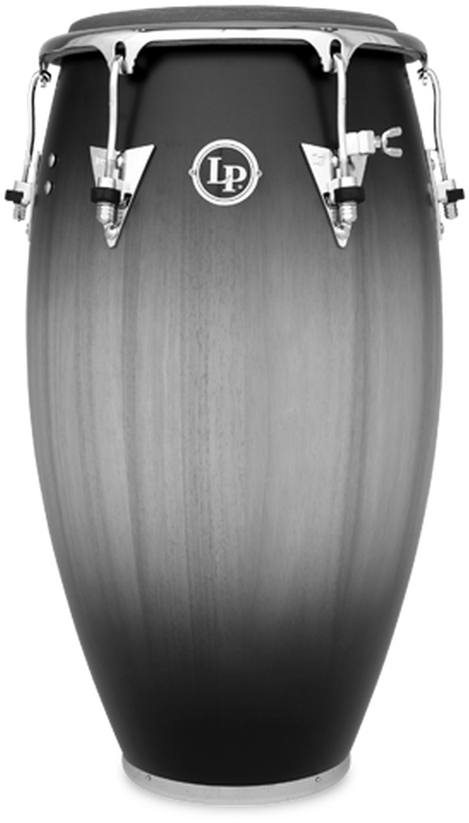
Hand Drums for Beginners
Djembe, Congas, & Bongo
McKayla Phillips
Adjunct Professor of Percussion - Shaw University
Friday, July 21, 2023
PAS FUNdamentals Friday
Notes:
Clap and play along

Slide 2
Djembe, Congas, & Bongo:
A Brief History
Djembe Origins: modern day Guinea, Mali, Burkina Faso, Côte d'Ivoire, Gambia, and Senegal (West Africa), approx. 12th century (Mandinka people)
Congas & Bongo Origins: Cuba, late 19th - early 20th century
Common Names for Congas
High: Quinto, Cachimbo, Niño
Middle: Conga, Tres Golpes, Tres per Dos, Segundo, Mula
Low: Tumba(dora), Salidor, Caja

Slide 3
Congas & Djembe:
The Instrument & Set-Up
Angle of the Drum & Body Set-Up
Angle the drum forward
Keep wrists straight & engaged
The angle of your wrist determines the sounds/tones
Seat Height
Adjust height if possible
Allow separation between the chest cavity and the elbow

Slide 4
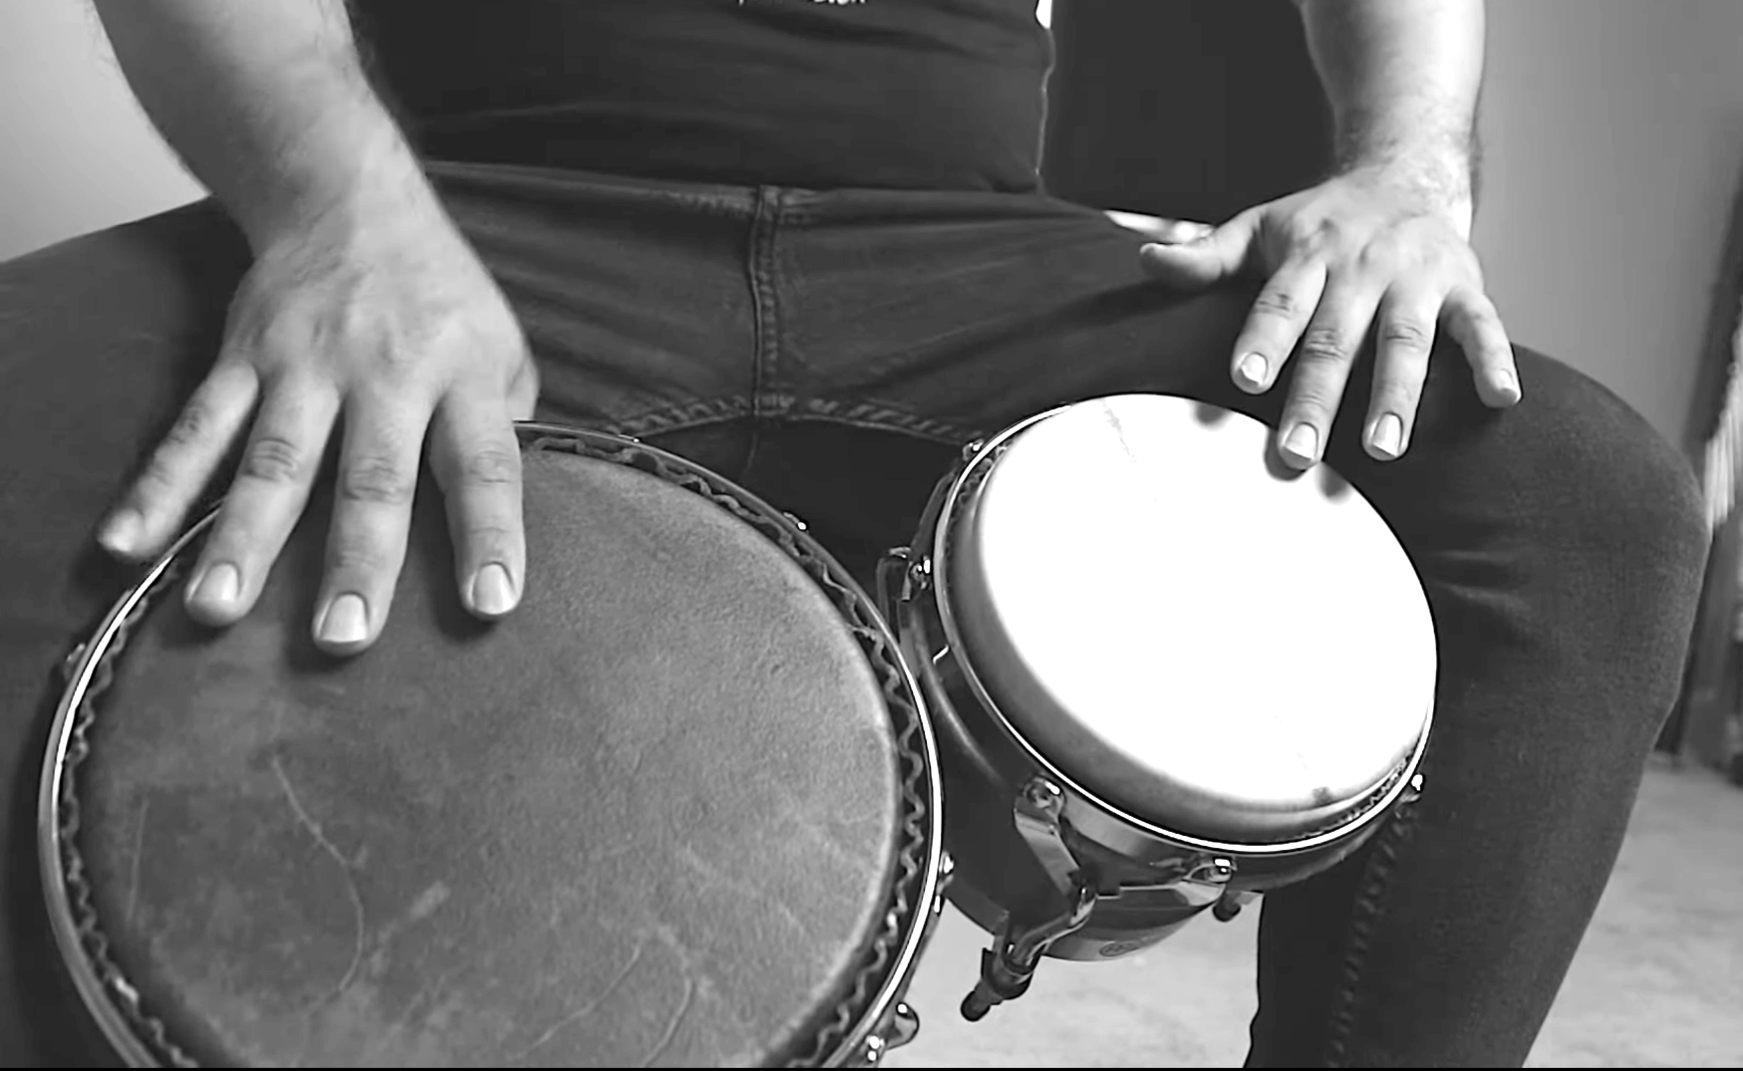
Bongo
The Instrument & Set-Up
Angle of the Drum & Body Set-Up
Held between the legs with the high head (macho) held up against the left leg and the low head (hembra) held down against the right leg
Seat Height
Generally, a very low seat/stool height is preferred
Strokes will be with smaller portions of the hands

Slide 5
Important Terms
Contact Point: where the hand makes contact with the head of the drum
Bearing Edge: where the head of the drum comes in contact with the shell of the drum

Slide 6
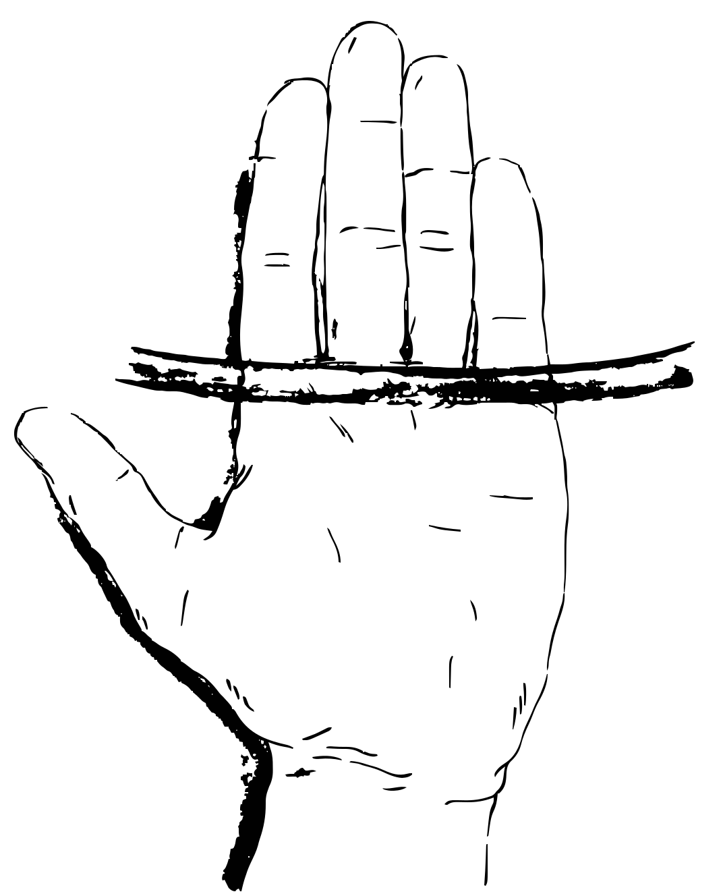
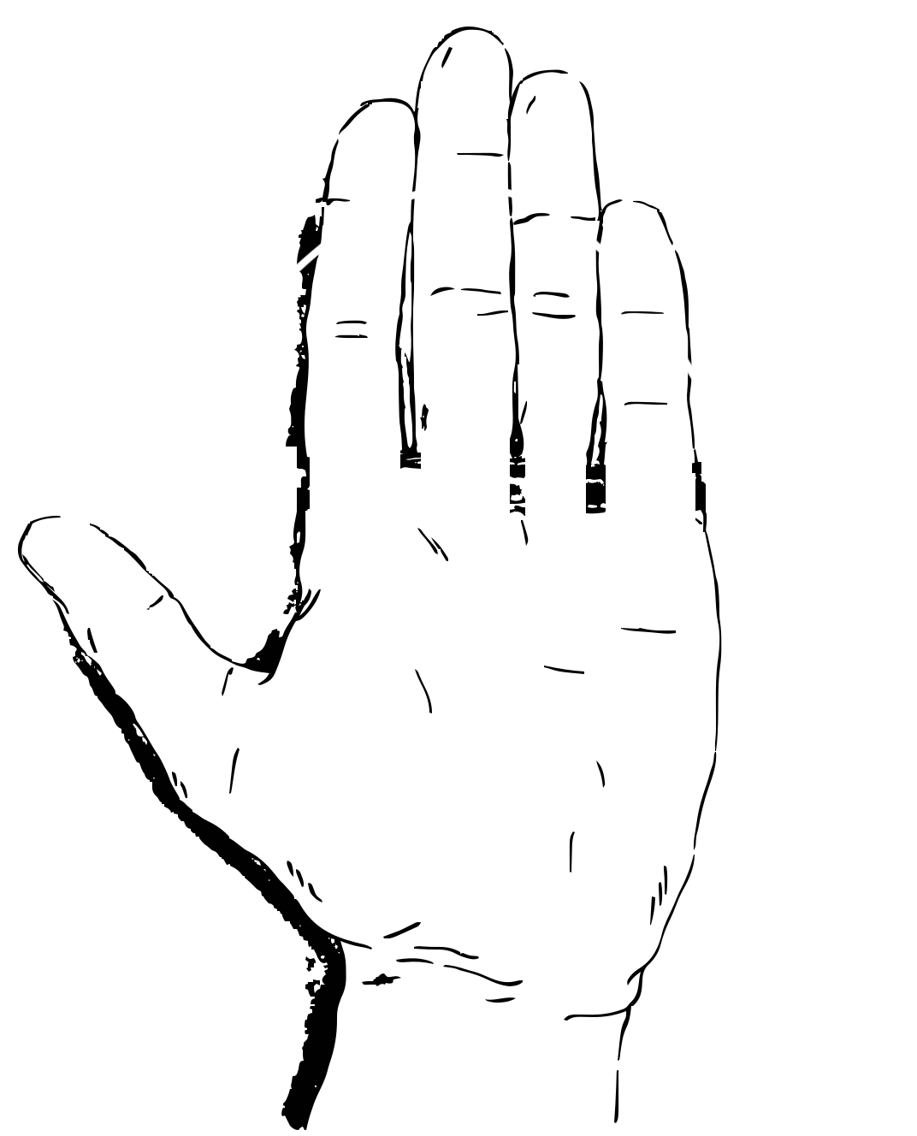
The Essential Tones:
Open, Muff, Slap, & Bass
OPEN
MUFF
BASS
SLAP
Wrists straight
Fingers together
Contact Point: middle of the fingers
Move (mostly) from the wrist
Rebound
Wrists straight
Fingers together
Contact Point: middle of the fingers
Move (mostly) from the wrist
NO rebound!
T-Rex arms
Contact Point: full flat palm
Relax & let go!
Wrists bent
Fingers naturally curved
Middle of palm on bearing edge
Contact Point: finger pads
Rebound for open (djembe) stay on head for closed (congas)

Slide 7
Notation Key
Alternating 8’s (chapoteo)
Alternating 8’s (double stop heel-toe)

Slide 8
8 On A Tone
Tone Paradiddles

Slide 9
Tone Paradiddles: Variation 1

Slide 10
Heel Toe 4’s
Heel Toe 3’s

Slide 11
Extended & Combination Strokes
Heel
Toe
Touch Tone
Same as the ‘bass’ tone
*technique shift when tempo increases*
Palm & fingers move down as a unit
*technique shift when tempo increases*
Quiet stroke that only YOU can hear
Used for timekeeping
Used on congas, bongo, & djembe!
Notes:
Heel, Toe only on congas

Slide 12
Essential Styles &
Where to Go From Here
Musical Styles & Concepts
Clave - both styles & directions (rumba & son, 2-3 & 3-2)
12/8 Bell Patterns - traditional, modern, & variations
Salsa
Rumba
Cha-Cha-Cha
Listening to Recordings & Attending Performances - rhythmic language and vocabulary
Historical Context - instrument, musical styles, rhythms, melodies, cultural context, and more are essential
Notes:
*** resources on sheet

Slide 13
Why, How, & What?
Why Teach It?
Approachability
Limited student financial investment
Student creativity, improvisation, & rote learning
Historical connections
Cross-Curricular opportunities
Increasing frequency in literature
How to Pay for It? - details in handout
Grants & Funding Opportunities
What to Buy? - details in handout
Nice Enough vs. Very Nice
Animal Skin Heads vs. Synthetic/Plastic Heads
See handout for details
Notes:
Handout as a reference. Links to video, playlist, places to buy drums, etc. ALL ON WEBSITE/YOUTUBE
ADD video here?

Slide 14
Questions?
Notes:
Handout as a reference. Links to video, playlist, places to buy drums, etc. ALL ON WEBSITE/YOUTUBE
Playlist link

Slide 15
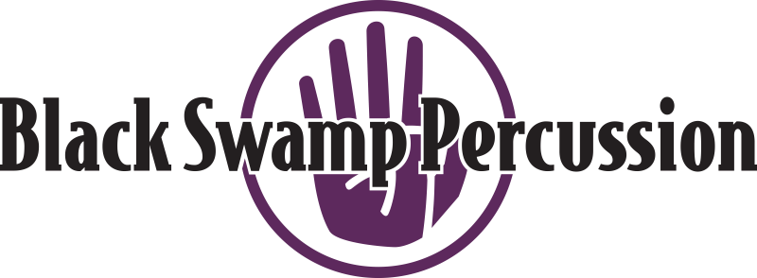
Thank You!
If you have any additional questions, feel free to email/DM at the links below:
mckaylaphillipspercussion@gmail.com
www.mckaylaphillips.com
Instagram: @mckayla_p
Facebook: mckayla.phillips.9

