Slide 1
Tips for Bridging the Gap:
Career Focused Instruction for Applied Lessons
McKayla Phillips
Lecturer of Percussion, University of North Carolina - Chapel Hill
Adjunct Professor of Percussion - Shaw University
Thursday, November 10, 2022 - 11:45 am
SCAN for Session Documents
Notes:
10 minutes total - 5 min set up

Slide 2
September 2022 Poll of 20 Percussionist Band Directors
95%
of directors polled stated that they felt either “fully unprepared” or “mostly unprepared” to teach woodwind & brass concepts to students going into student teaching
Notes:
Add Personal & Anecdotal Experience

Slide 3
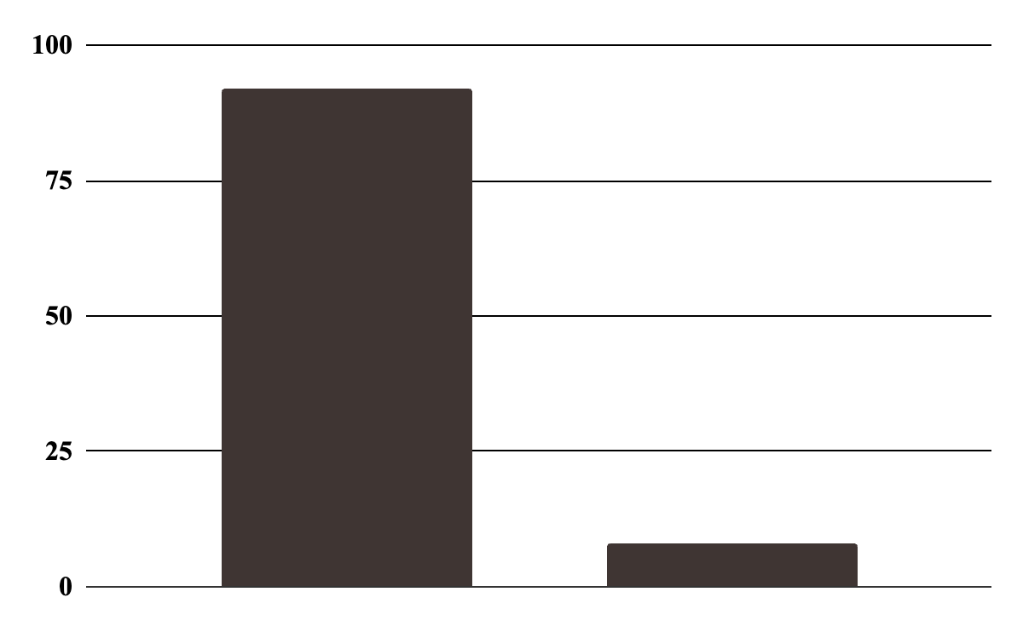
August 2022 Poll of 1,500 Band Directors
“Percussionist Band Directors are held more responsible for what they don't know about wind instruments than Wind Instrument Band Directors are for what they don't know about percussion.”
92% Agree
8% Disagree
Agree
Disagree
Source: Band Directors Facebook Group - poll by Brian Sims

Slide 4
August 2022 Poll of 1,500 Band Directors
“Percussionist Band Directors are held more responsible for what they don't know about wind instruments than Wind Instrument Band Directors are for what they don't know about percussion.”
92% Agree
8% Disagree
Agree
Disagree
Overall, percussionists feel unprepared entering the workforce!
Source: Band Directors Facebook Group - poll by Brian Sims
Notes:
So… how can we help?

Slide 5
How can we help?

Slide 6
Identifying the Gaps
Assumed knowledge - percussion students are at a disadvantage
Wind & Brass students generally have 7+ years of experience in:
Breathing/Breath Support
Tonguing
Forming an embouchure
Differing articulations with the mouth and when to apply them
Performing and memorizing fingerings
Phrasing with air
Tone Production
Transposing
Intonation & Fine Tuning

Slide 7
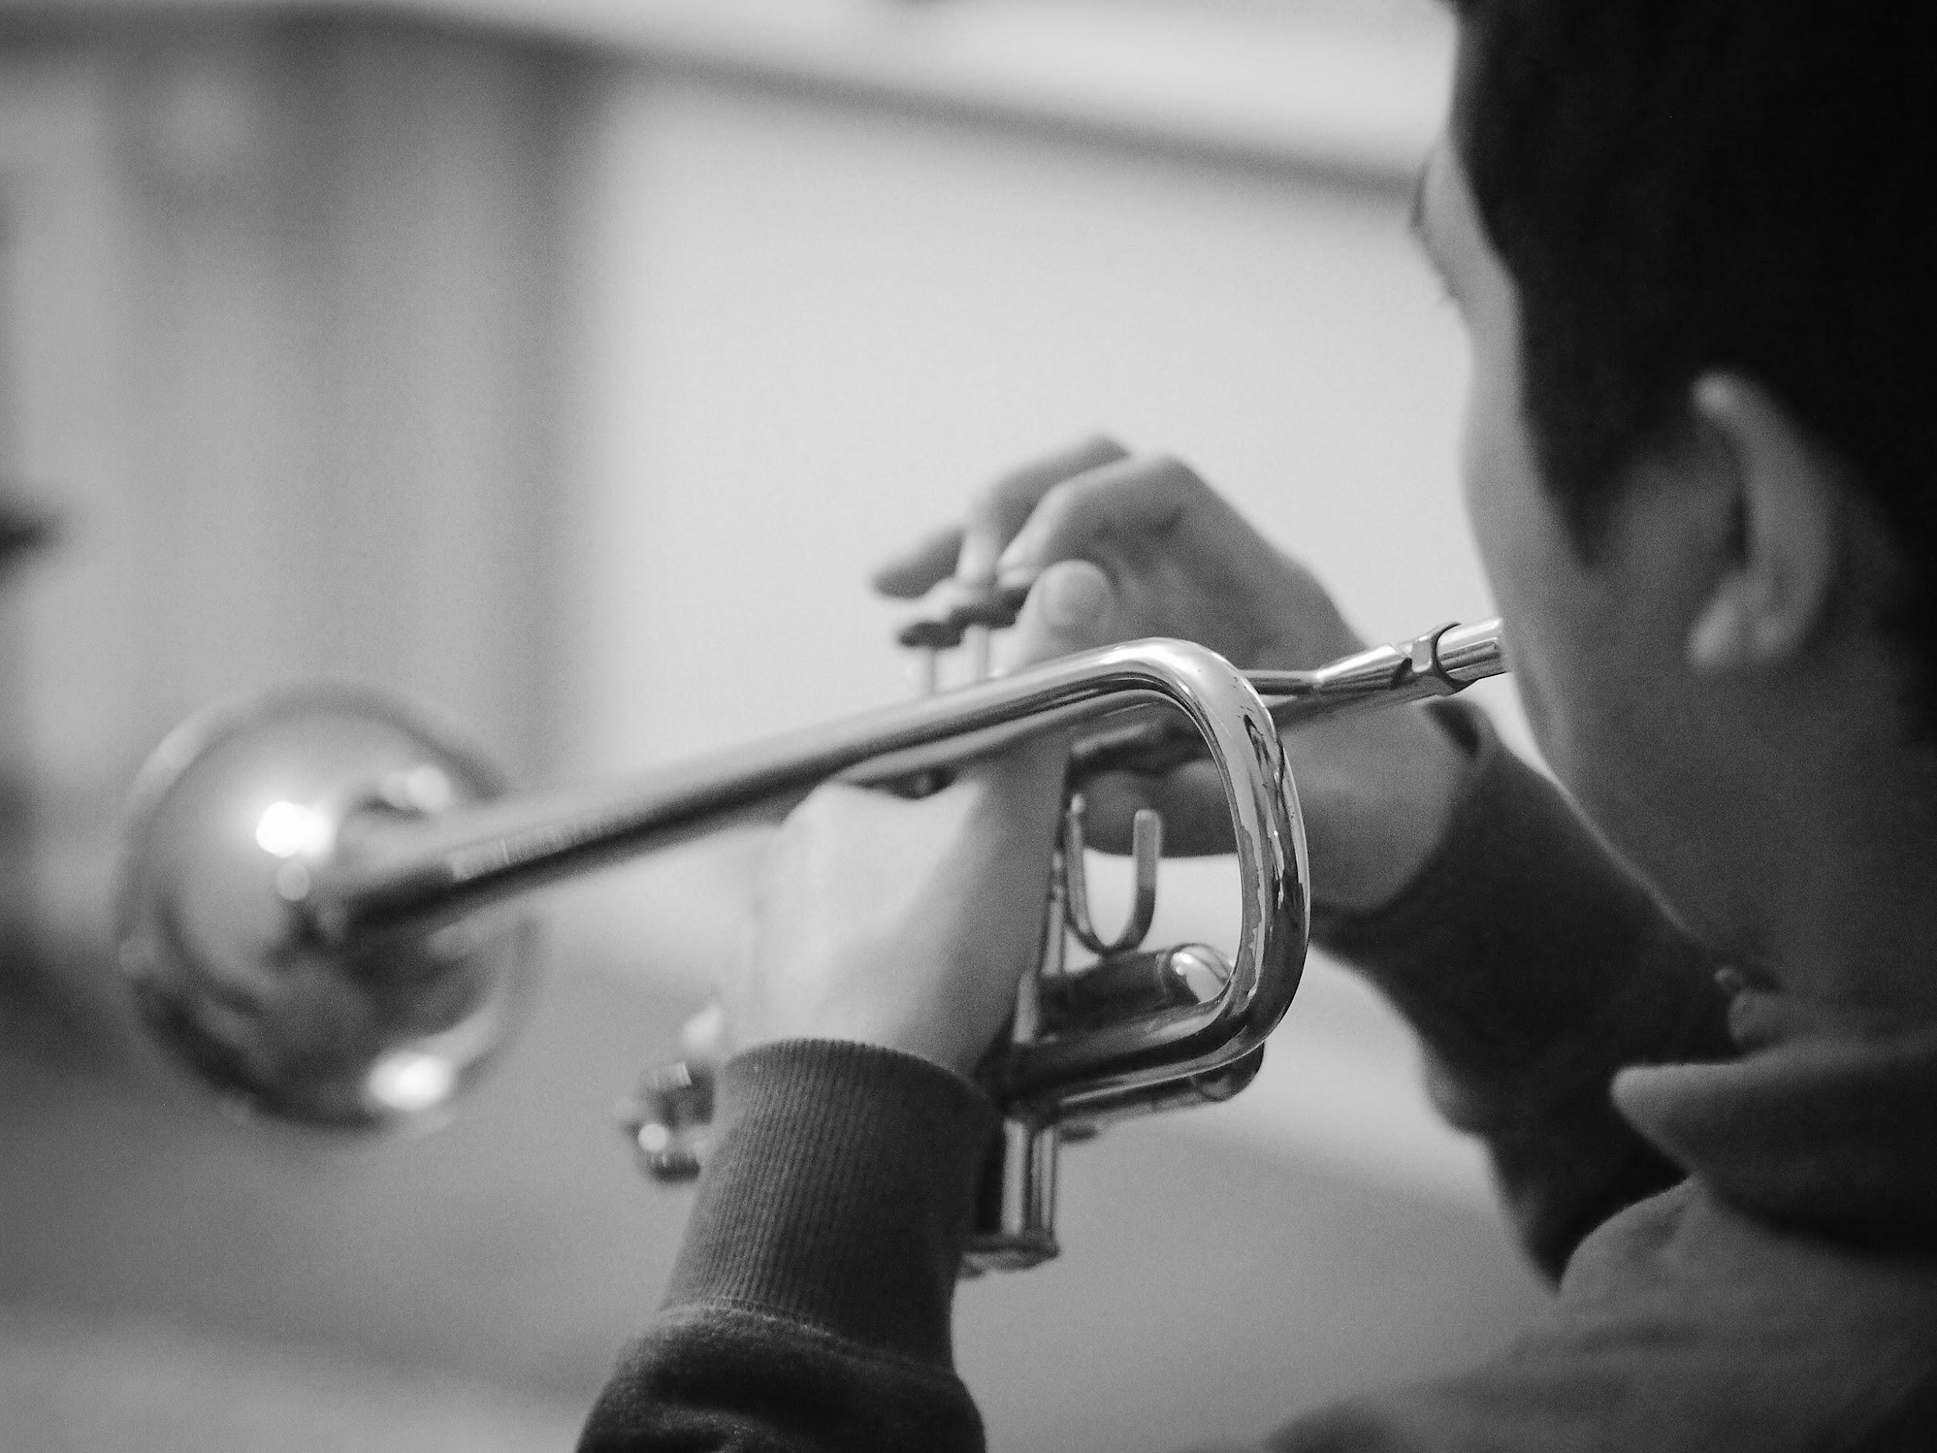
Common Music Education Teaching Coursework
Woodwind Methods
Brass Methods
Percussion Methods
String Methods
Vocal Methods
Lab Bands or Lab Teaching Courses
Maximum of 5 semesters focusing on non-percussion pedagogy
Notes:
UM, UNCG, IU, UNT, Eastman
Gaps can be addressed and supplemented within the private lessons environment

Slide 8
Common Music Education Teaching Coursework
Woodwind Methods
Brass Methods
Percussion Methods
String Methods
Vocal Methods
Lab Bands or Lab Teaching Courses
Maximum of 5 semesters focusing on non-percussion pedagogy
Gaps can be addressed and supplemented within the private lessons environment
Notes:
UM, UNCG, IU, UNT, Eastman
Gaps can be addressed and supplemented within the private lessons environment

Slide 9
Bridging the Gap
How can we integrate the wind/string/vocal concepts students are learning in their coursework directly into daily practice?
Remind students that their musical experiences should not be separate, but combined and transferred from one area to another to maximize efficacy in learning
Notes:
Silos - jim campbell
Marching band brain- in my experience, beginning students who like to compartmentalize/silo

Slide 10
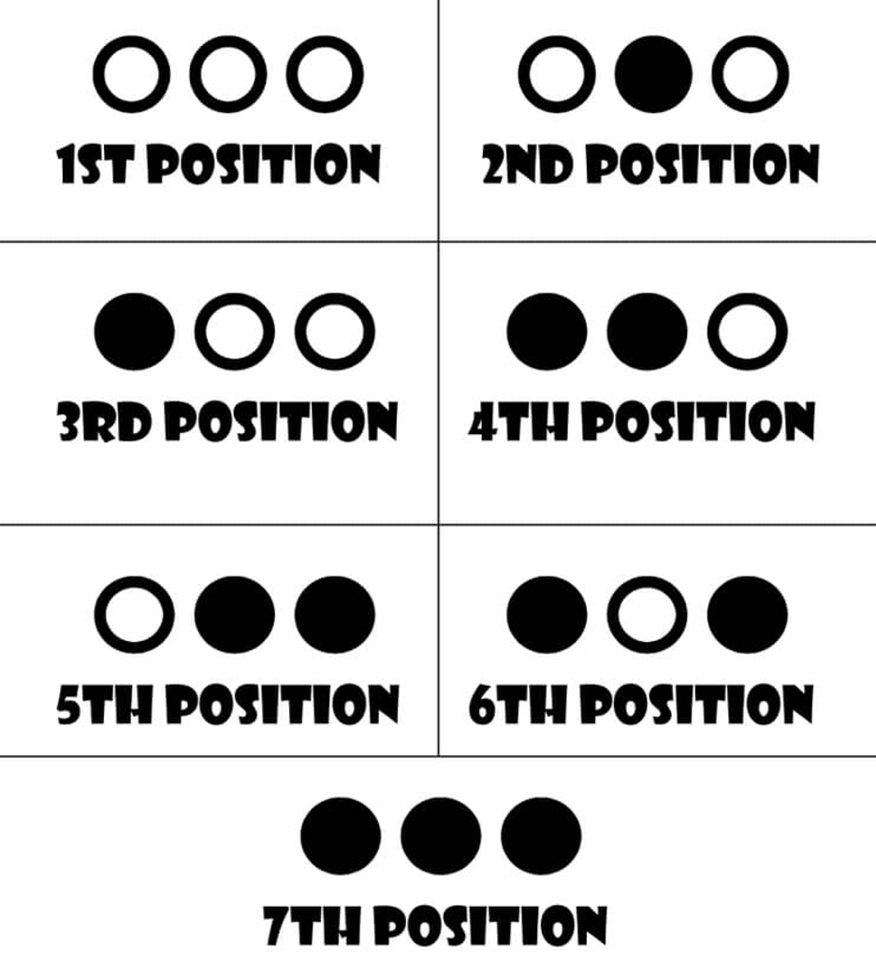
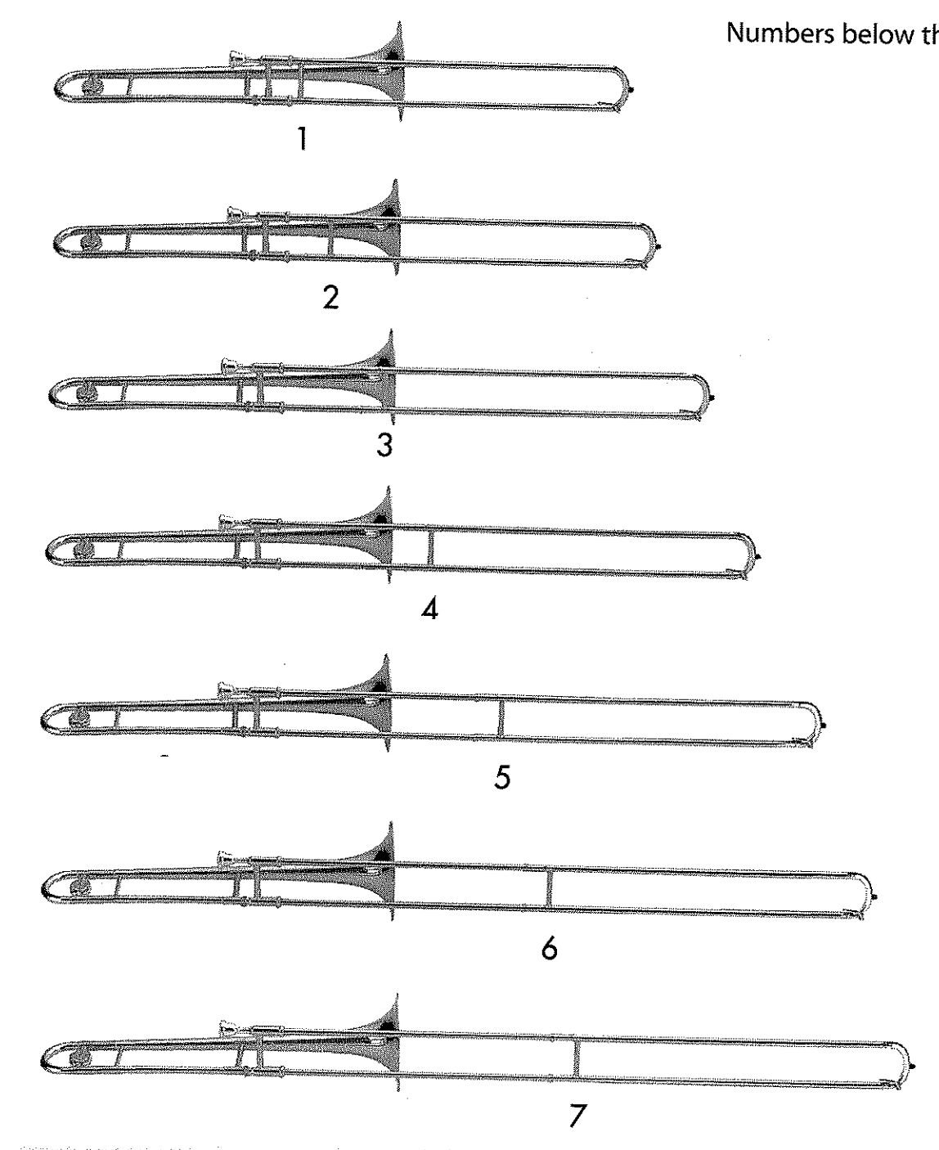
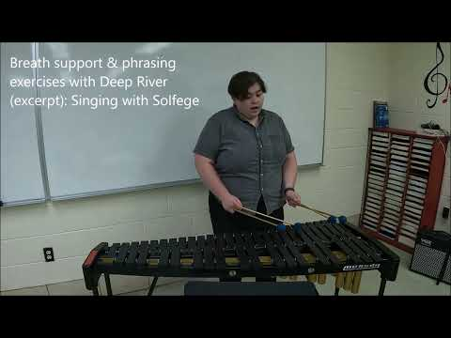
Bridging the Gap - Playing Examples
Play keyboard scales while speaking brass positions
Works on: trombone, trumpet, & euphonium positions

Slide 11
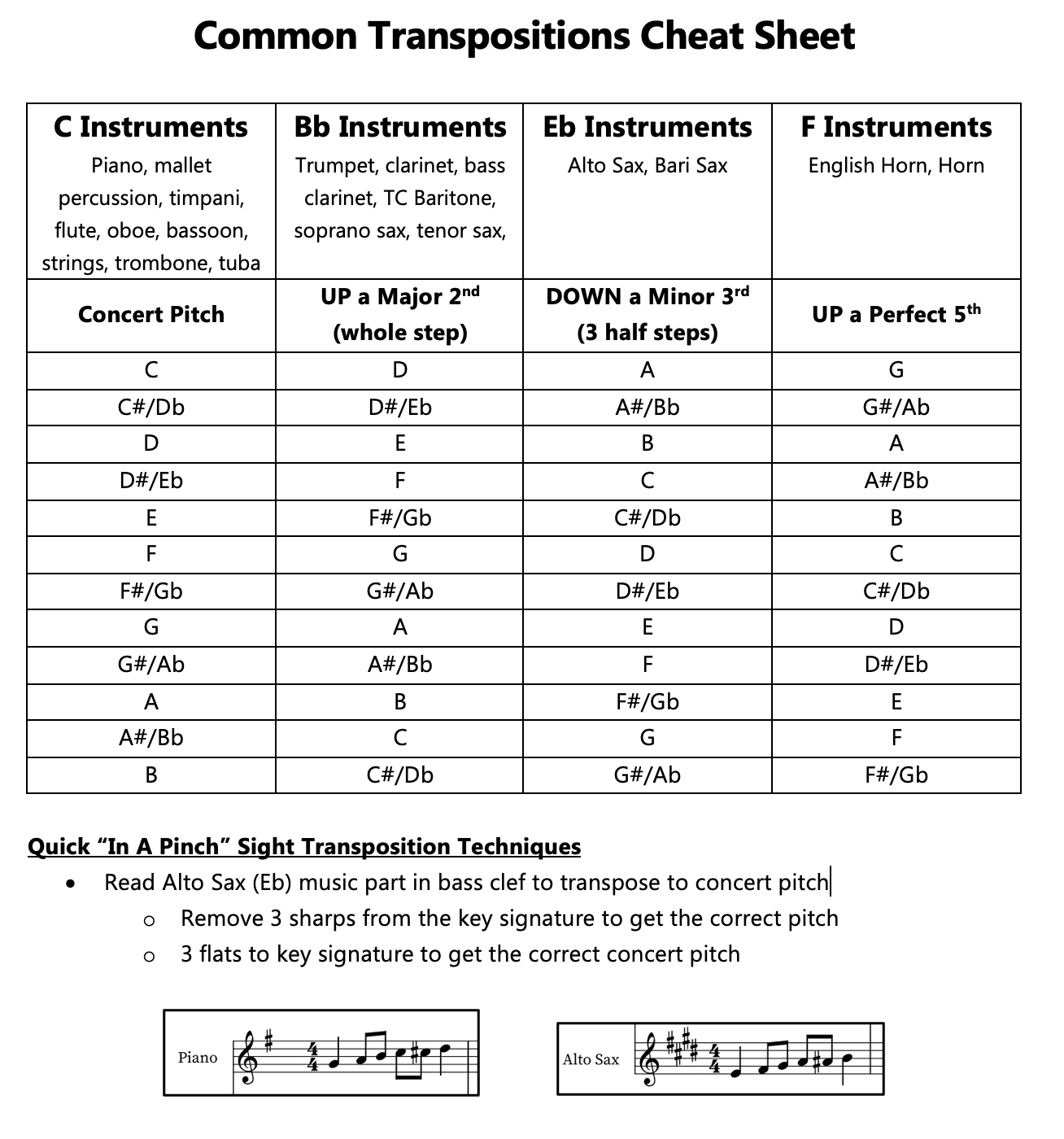
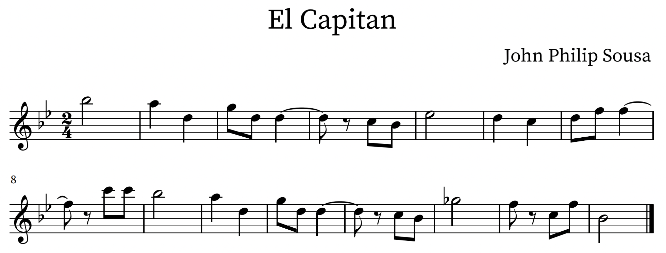
Bridging the Gap - Playing Examples
Sight-reading melodies while speaking pitch transpositions
Works on: sight transposition (brass & woodwind)
Notes:
Helps with

Slide 12
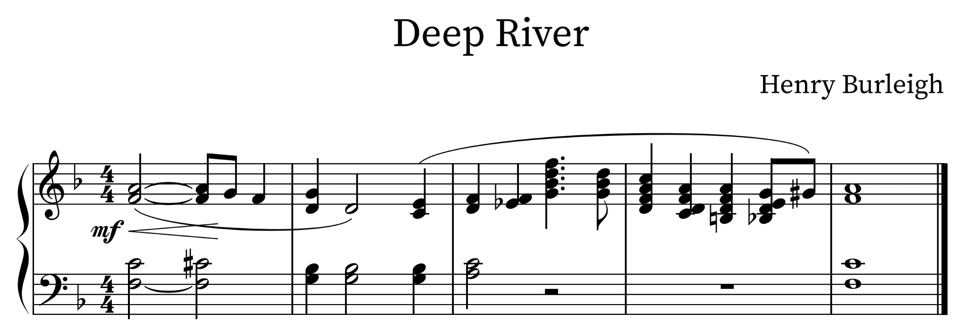
Bridging the Gap - Playing Examples
Singing (solfege, scale degrees, or vowel syllables) melodic lines while playing
Works on: solfege identification, phrasing, breath/air support, vowel sound clarity, singing skills
Notes:
Other examples on handout

Slide 13
Bridging the Gap - Everything Else
Section Set-Up
Equipment
What’s wrong with this picture/video?
Moving considerations & stage plots
Storage Logistics
Planning
Storage of equipment & its maintenance
Rehearsals, part assignments, and more
Notes:
Performance Logistics Project example, Part Assignments excel sheet, example stage plot,

Slide 14
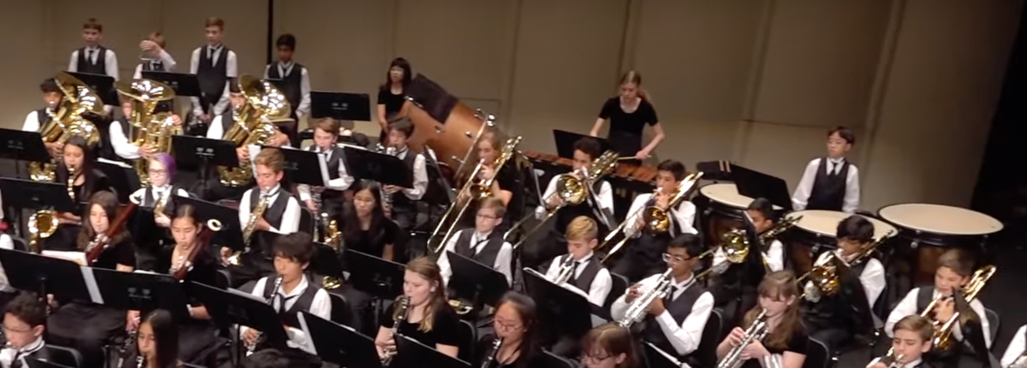
Bridging the Gap - Everything Else
Section Set-Up
Equipment
What’s wrong with this picture/video?
Moving considerations & stage plots
Storage Logistics
Planning
Storage of equipment & its maintenance
Rehearsals, part assignments, and more
Notes:
Performance Logistics Project example, Part Assignments excel sheet, example stage plot,

Slide 15
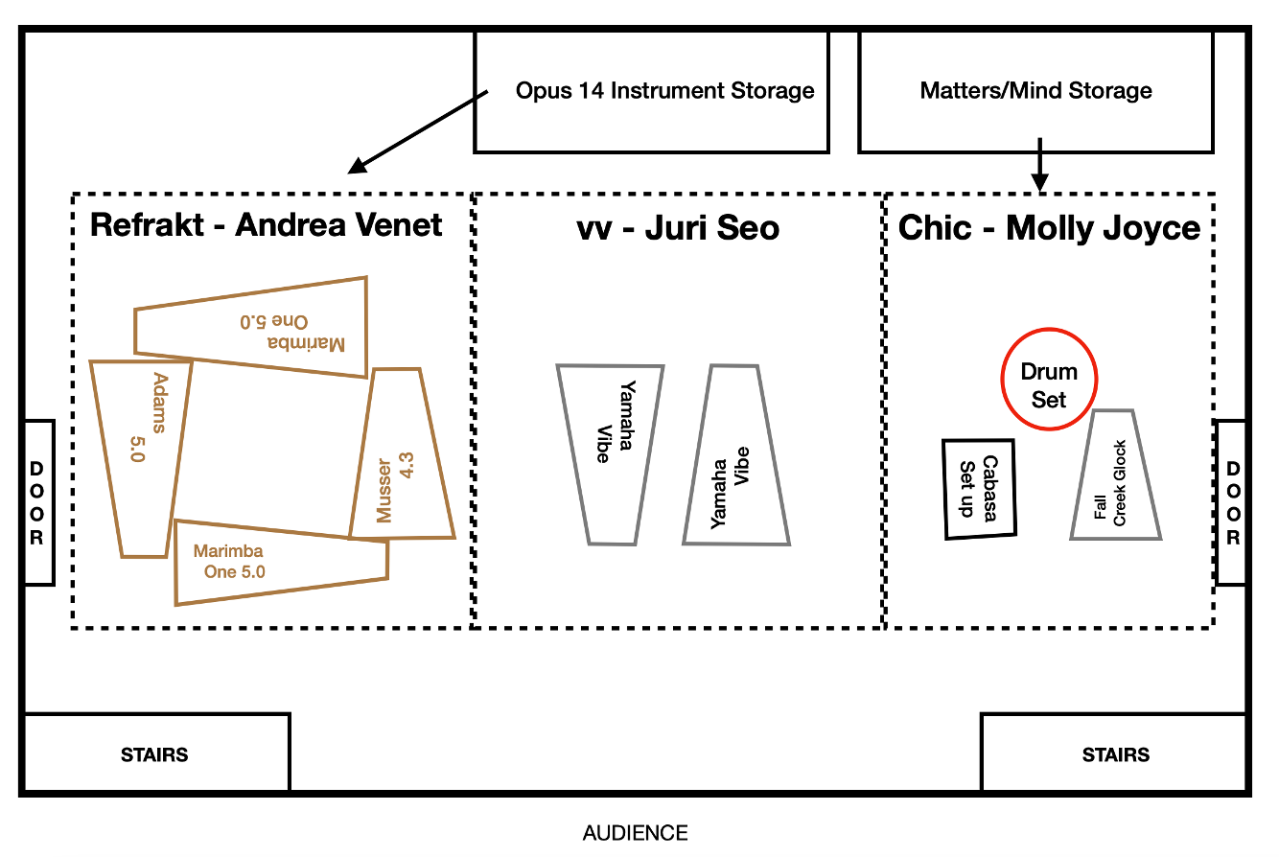
Bridging the Gap - Everything Else
Section Set-Up
Equipment
What’s wrong with this picture/video?
Moving considerations & stage plots
Storage Logistics
Planning
Storage of equipment & its maintenance
Rehearsals, part assignments, and more
Notes:
Performance Logistics Project example, Part Assignments excel sheet, example stage plot,

Slide 16
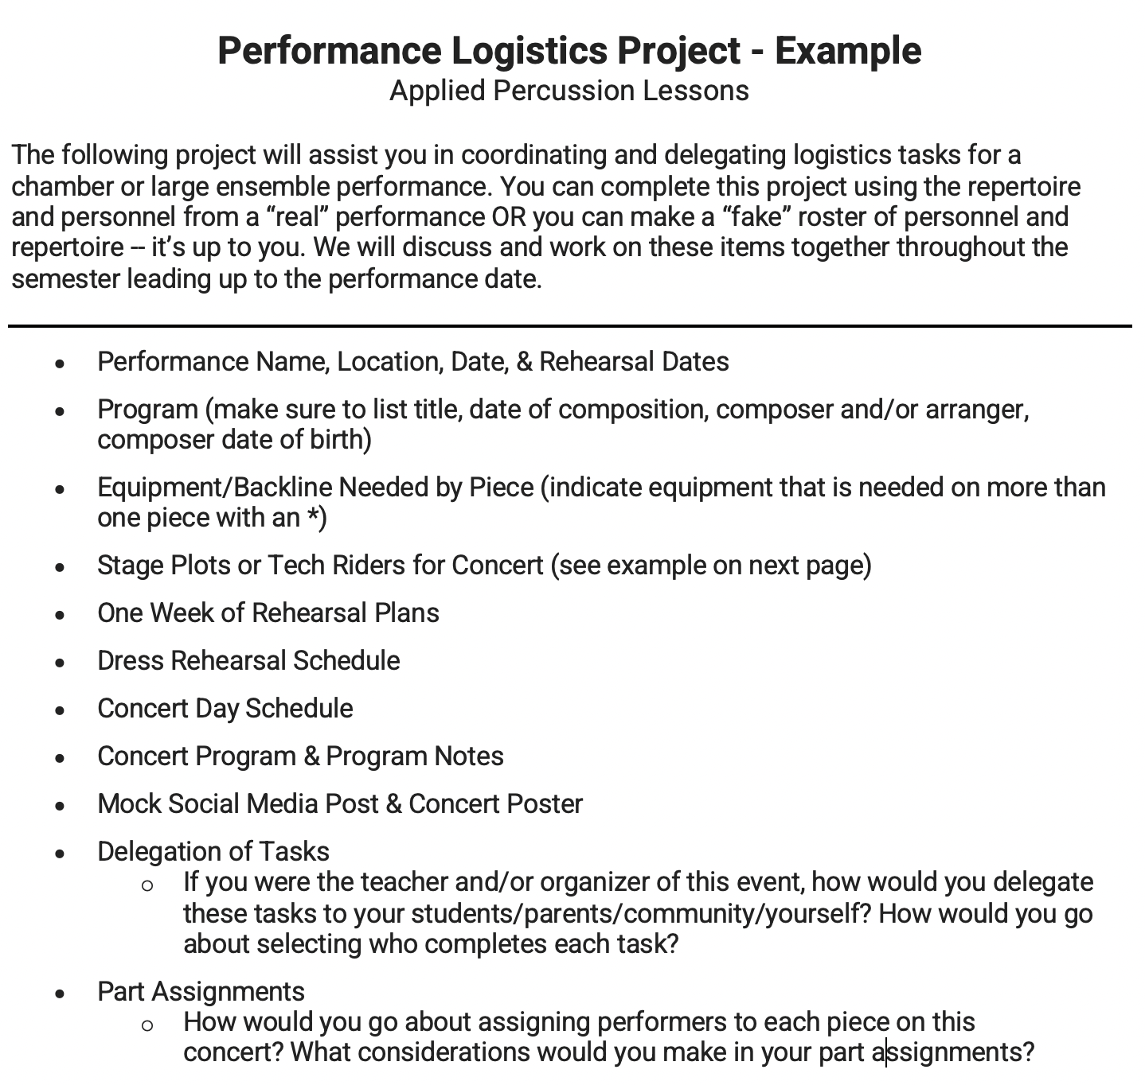
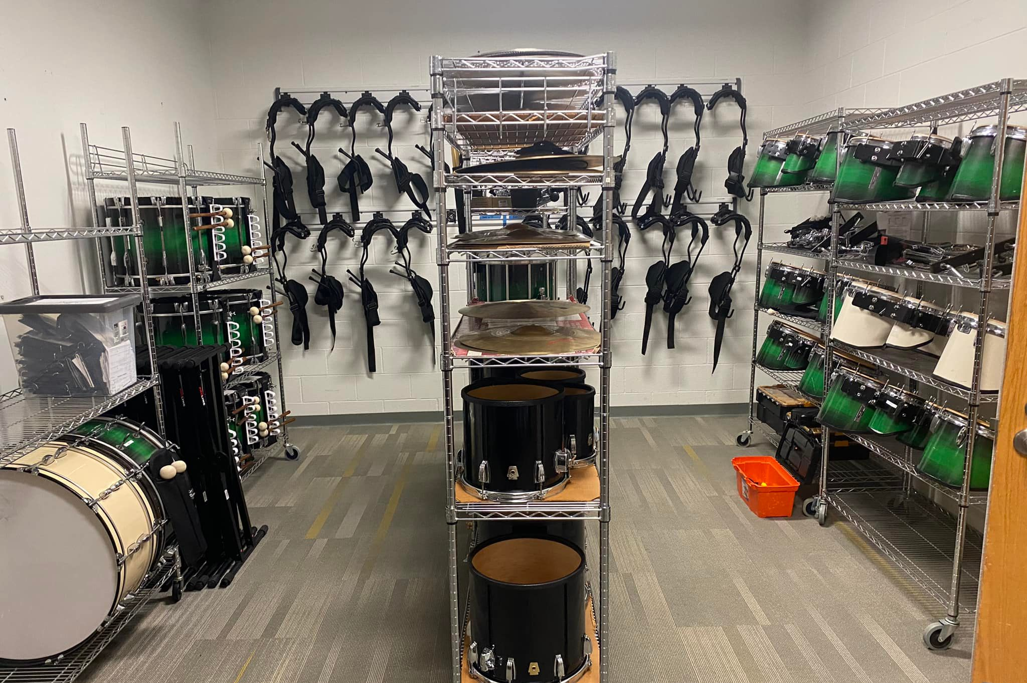
Bridging the Gap - Everything Else
Section Set-Up
Equipment
What’s wrong with this picture/video?
Moving considerations & stage plots
Storage Logistics
Planning
Storage of equipment & its maintenance
Rehearsals, part assignments, and more
Notes:
Performance Logistics Project example, Part Assignments excel sheet, example stage plot,

Slide 17
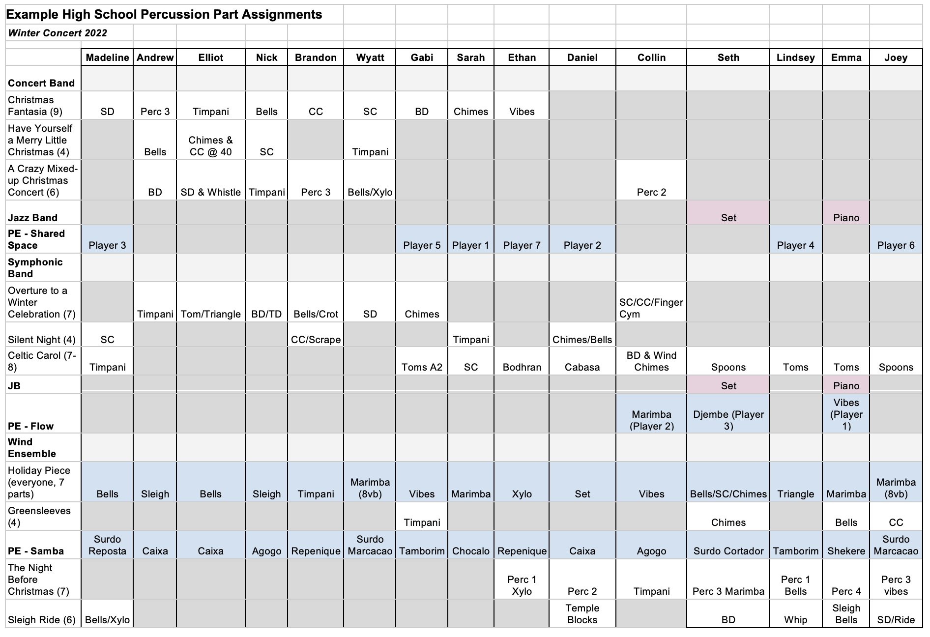
Bridging the Gap - Everything Else
Section Set-Up
Equipment
What’s wrong with this picture/video?
Moving considerations & stage plots
Storage Logistics
Planning
Storage of equipment & its maintenance
Rehearsals, part assignments, and more
Notes:
Performance Logistics Project example, Part Assignments excel sheet, example stage plot,

Slide 18
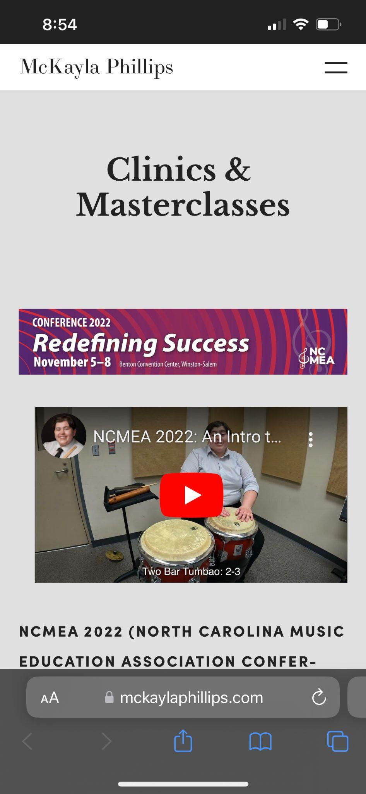
For more information:
Questions?
Visit www.mckaylaphillips.com
SCAN for Session Documents

Slide 19
Thank You!
If you have any additional questions, feel free to email/DM at the links below:
mckaylaphillipspercussion@gmail.com
www.mckaylaphillips.com
Instagram: @mckayla_p
Facebook: mckayla.phillips.9

